Slide 1

UST RIPPLE · TEAM 1075
RIPPLE
Test the detour
before you send it
AI incident copilot for Hong Kong traffic operators
Track 1: Green Transport & Smart Mobility
Lead Data Simulation Visuals Impact
Notes:
One crash. Two possible detours. Which one actually helps the corridor? Traffic operators face that network decision under pressure. Ripple helps them test response options before advice reaches drivers. We combine a language model that understands incident reports with a road-network simulator that measures what each response could do. The operator makes the final call.
Sources and presenter context: Cover roles are placeholders until the team supplies full names and universities. Track 1 wording: Hack4SDG 2026 final submission page. Artwork is conceptual, not traffic evidence.

Slide 2
RIPPLE / 02
One closure changes the whole corridor
One blocked link
Traffic shifts
Operator weighs impact
!
?
A detour can move congestion to the next road.
UST Ripple · Hack4SDG 2026
02
Notes:
A navigation app optimizes one trip. An operator has to protect the corridor. Sending every driver to the same alternative can simply move the jam. Today, the hard part is comparing the consequences quickly enough to support a clear, defensible message. That is the decision Ripple is built around.
Sources and presenter context: Conceptual editable diagram, not a geographic network or measured flow. Product scope: docs/00-brief.md.

Slide 3
RIPPLE / 03
From bulletin to tested response
01
02
03
04
05
TD notice
Reader
Guardrails
Simulator
Operator
Bilingual source
Local Qwen3:8b
Route + capacity
Seeded SUMO
Review + approval
AI proposes
Simulation measures
Operator decides
UST Ripple · Hack4SDG 2026
03
Notes:
Ripple begins with the Transport Department's bilingual incident notice. A local Qwen3:8b Reader turns the notice into structured incident fields. A second AI stage proposes an action. We compare it with fixed no-advice and broad-advice baselines, while deterministic checks constrain routes and capacity. Then we run seeded SUMO scenarios and compare modelled corridor delay. The console shows a ranking when the evidence separates the options, or holds a recommendation when it does not. The language model never calculates the traffic metric. The simulator does, and a human operator approves what happens next.
Sources and presenter context: Product contracts: docs/03-architecture.md. Metrics are simulator outputs stored under results/. The diagram describes the prototype workflow.

Slide 4

RIPPLE / 04
The Reader turns a notice into incident data
“part of the lanes”
lane count:
unspecified
Recorded local Qwen3:8b inference
Aberdeen, 15 May 2026 · archived message and saved extraction
UST Ripple · Hack4SDG 2026
04
Notes:
This is the working Reader, not a concept mockup. In one archived Aberdeen notice, the source says only that “part of the lanes” are closed. The saved Qwen3:8b extraction identifies the road, direction, and incident type, while leaving the lane count unspecified. That structured output feeds the response workflow. We retain the source notice and the recorded model call so an operator can inspect what the AI used.
Sources and presenter context: Screenshot copied from Visuals unmerged branch origin/visuals/console-demo-oct13:docs/img/console-reader-2026-10-13.png. Underlying recorded inference: evidence/demo/recorded-genai-bd-2026-10-13.html. Not a live model call.

Slide 5
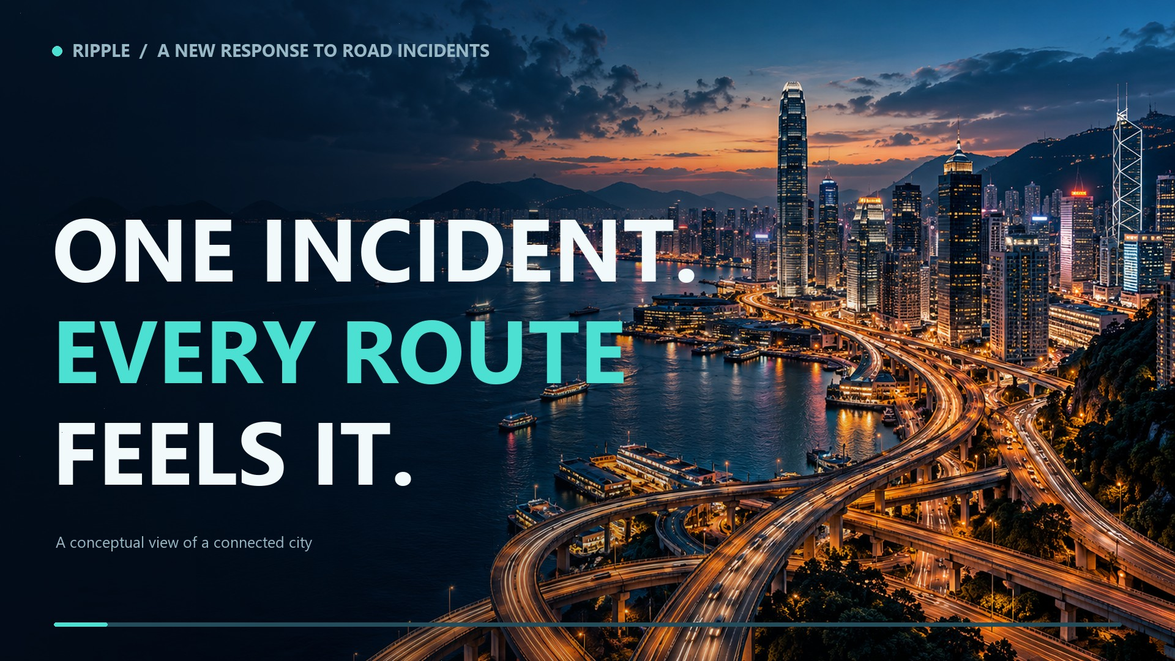
Prototype demo · 90 seconds
Ripple product reveal • 60-second film • Music and sound design; narration to follow
Notes:
The 60-second Ripple product reveal auto-plays on this slide. It is a conceptual opening film with original music and sound design; narration and presenter script will be developed after visual review. The Hong Kong aerial is AI-generated conceptual atmosphere, the network and plan motion are illustrative graphics, the Reader card draws from recorded archived evidence, and the Tuen Mun map uses saved TD detector windows and Visual's CARTo/OpenStreetMap prototype. The film intentionally avoids case outcome numbers; subsequent slides present the Aberdeen and Tuen Mun evidence. Do not use the opening visual as a depiction of a specific incident or live deployment.

Slide 6
RIPPLE / 06
A one-corridor path to a supervised pilot
01
02
03
Shadow mode
Corridor validation
Supervised pilot
Run beside current practice
Improve queue fit and routes
Measure real decisions
Measure observed delay, spillover, emergency travel time, and decision quality.
UST Ripple · Hack4SDG 2026
06
Notes:
Our next step is one corridor, with an operator partner. First, run Ripple in shadow mode beside existing practice. Then improve the queue fit, confirm acceptable diversion routes, and test the console with operators. In a supervised pilot, measure observed delay, spillover, emergency travel time, and decision quality. Local Qwen3:8b, open aggregate Transport Department data, seeded SUMO runs, and a Streamlit console give us a practical starting point for that trial.
Sources and presenter context: Proposed next steps, not completed deployment or a claim of measured benefit. Product scope: docs/00-brief.md.

Slide 7
UST RIPPLE · TEAM 1075
Give us one corridor
to test it
Working AI Reader
Modelled response options
Operator approval at the final step
Help operators make the next move with evidence.
Notes:
Ripple turns a messy incident bulletin into response options an operator can test. We have a working AI Reader, an operator console, and two archived cases showing when to hold and when targeted advice leads in the model. Give us one corridor to prove the next step.
Sources and presenter context: Closing ask is a proposed one-corridor shadow trial and supervised pilot. Artwork is conceptual.

Slide 8
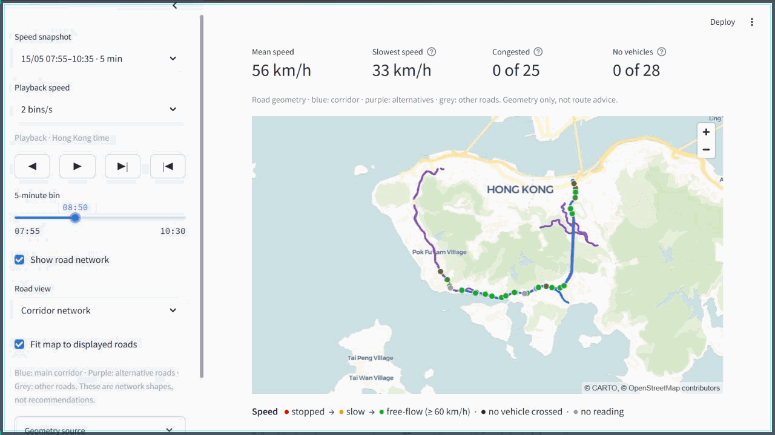
RIPPLE / A1
Aberdeen: the tested options tie
RETROSPECTIVE TD + DETECTOR PLAYBACK · 15 MAY 2026
HOLD
P0 and P2 tie
No route advised
30 scored model
conditions
UST Ripple · Hack4SDG 2026
A1
Notes:
Speak over playback. Here is the Aberdeen corridor on 15 May. The playback follows archived detector bins and published incident messages. It shows the operator what was observed and when the reports appeared. In the frozen comparison across 30 scored model conditions, no-added-advice P0 and targeted P2 tie under our ranking rule; the broad detour trails. Ripple holds the recommendation. It does not force a winner when the tested options do not separate.
Sources and presenter context: Animation assembled from the Visuals unmerged branch console using archived bins, not a vehicle simulation or live alert. Frozen result: docs/demo-two-incidents-2026-10-16.md and results/demo-oct16/. HOLD is the current main ranking verdict, not the older Visuals branch Operator review tab. Simulation provenance correction (18 Oct): Aberdeen’s saved refusal is a diagnostic. The provenance sidecars hash the network, detector loops, routes, observations and speed-sign inputs, but those five original files are absent from merged main at cf78b91. Do not describe this pack as fully reproducible from the repository until the original inputs are preserved.

Slide 9
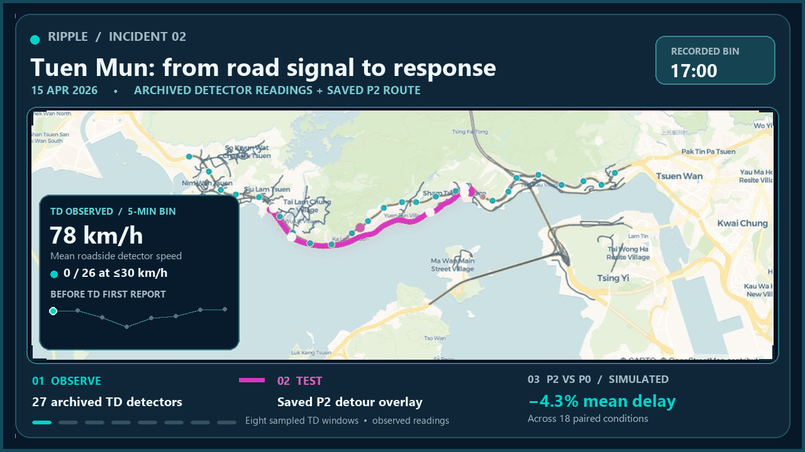
Notes:
Tuen Mun case: this replay samples eight archived TD five-minute detector windows from 17:00 through 20:25 on 15 April 2026. The basemap is CARTo/OpenStreetMap. The 27 detector dots show observed readings at each selected time. The magenta Castle Peak Road P2 route and modeled crash location come from the saved simulated scenario; they are not observed vehicle trajectories or live control advice. The matching scenario and network hashes are checked by the console. The animated rail shows observed mean speed and counts at each sampled bin; these are not outcomes of P2. The fixed comparison panel reports P2's 4.31% lower mean simulated total delay than P0 across 18 paired conditions. Slide 10 expands the frozen comparison.

Slide 10
RIPPLE / A3
Tuen Mun: targeted advice leads in the model
Change in simulated total delay vs no advice
AI proposed 80%
11%
P1 broad advice
+37.3%
eligible drivers after
capacity rule
P0 no advice
0%
17 / 18
P2 targeted advice
−4.3%
P2: lower modelled delay
−10
0
+10
+20
+30
+40
Modelled delay only. Queue too fast, clears early; reopening flow too high.
UST Ripple · Hack4SDG 2026
A3
Notes:
For this incident, the AI proposed a targeted diversion. A deterministic capacity check bounded advice from 80% to 11% of eligible drivers. Across 18 scored scenarios, P2 produces 4.3% less simulated total delay than no advice and is lower in 17 of 18. Broad P1 adds about 37%. That makes targeted advice the strongest tested option in this model. The replayed queue still needs better calibration, so this is a prototype comparison, not measured road savings.
Sources and presenter context: Frozen Tuen Mun result: docs/tuen-mun-simulation-final-call-2026-10-15.md and results/demo-oct16/. Exact values: P2 -4.31%, P1 +37.31% vs P0 across 18 conditions. P2 lower in 17/18; paired 95% CI -5.59 to -3.03%. The replay queue is ~42 km/h versus observed ~21 km/h and clears early.

